Slide 1
A peculiar issue…

Slide 2
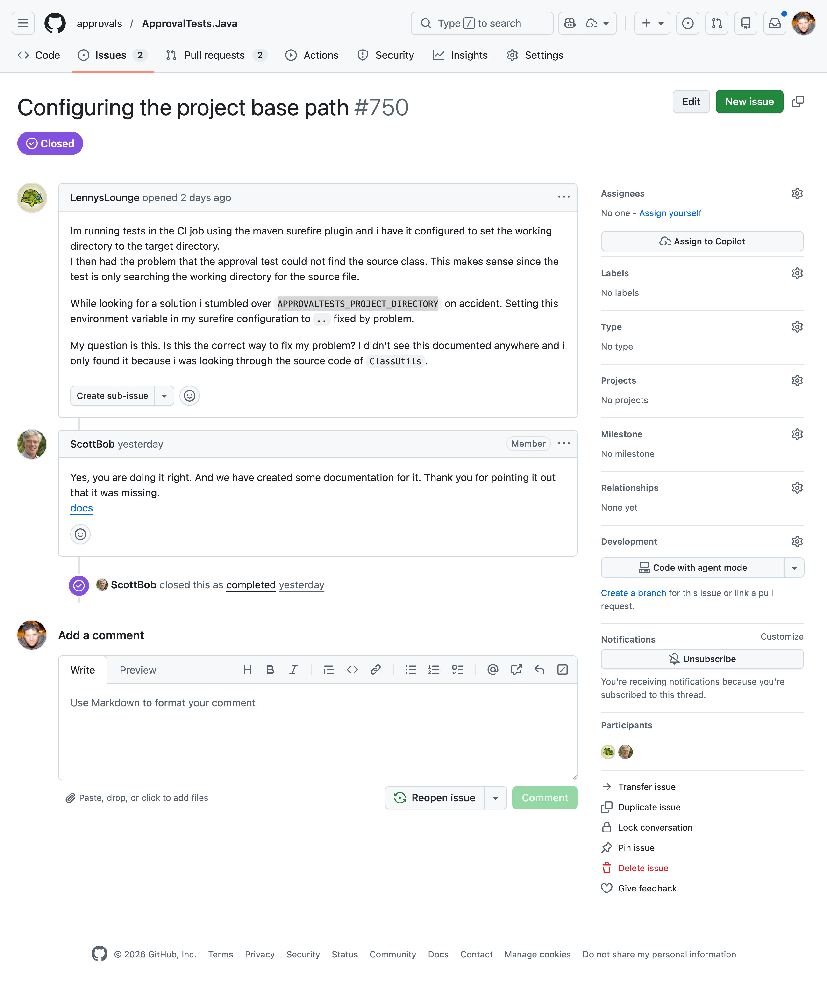

Slide 6
TUTORIALS
HOW-TO GUIDES
EXPLATATION
REFERENCE
*Daniele Procida's theory of documentation

Slide 7
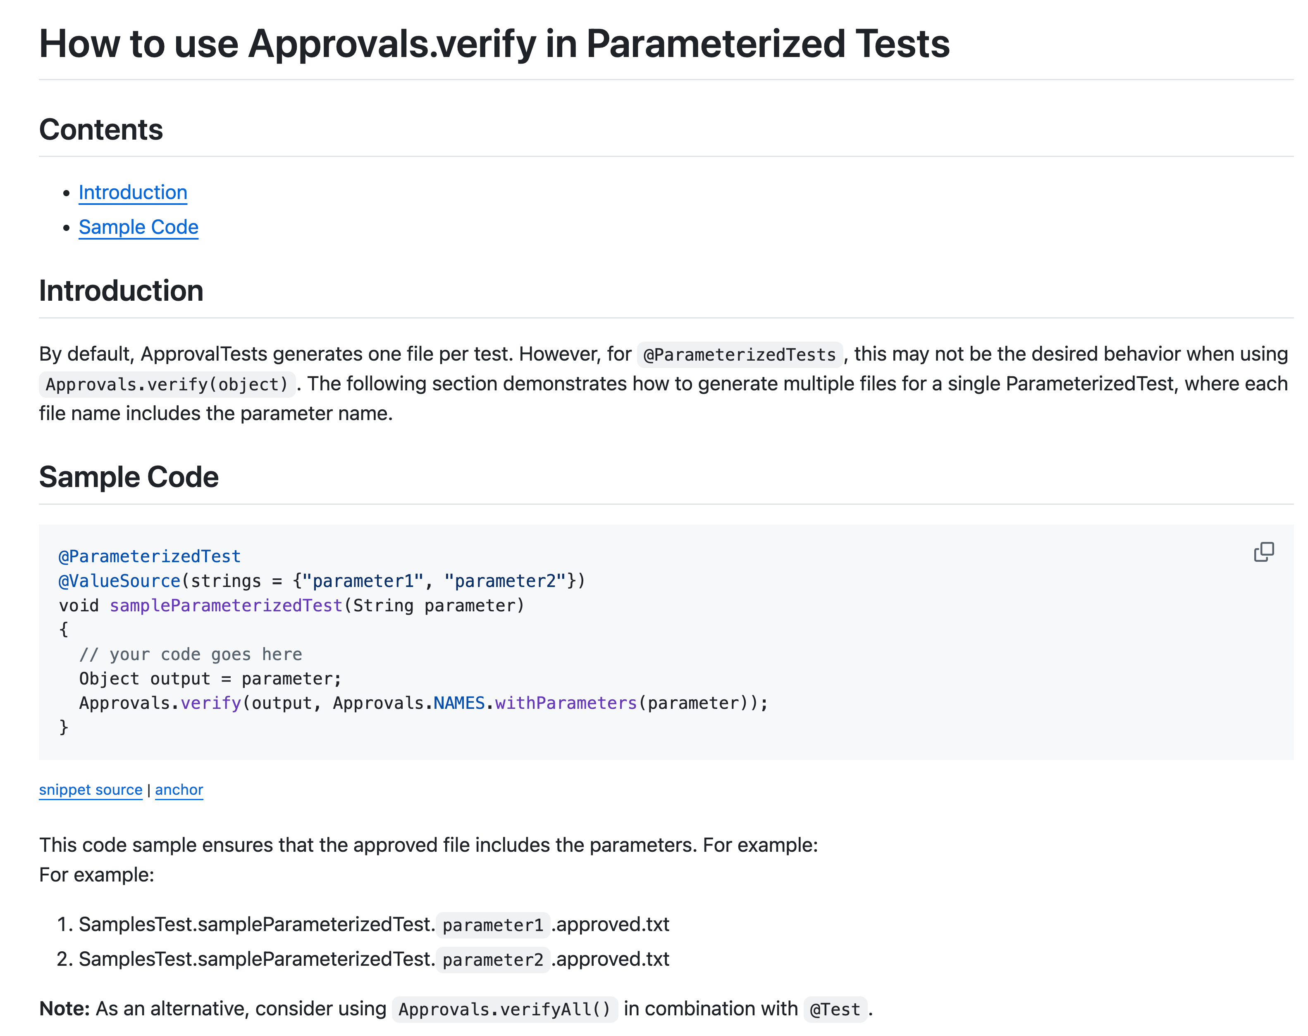

Slide 8
Please read issue 750 & 608 using the github cli. This is the right solution, but we need to make a how doc. You can see an example here @ParameterizedTest.md

Slide 9
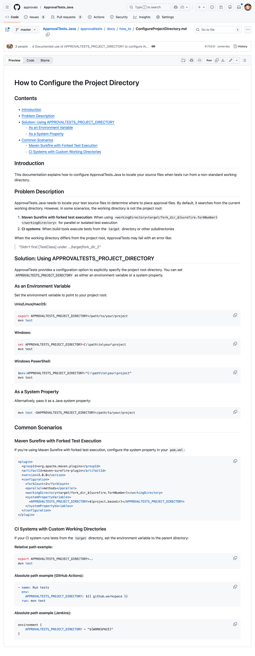

Slide 13



Components
of the AI Prompt
Issue 750
+
Issue 608
Code Base

Slide 14

Components
of an Effective AI Prompt
Structured
Built
Impromptu
+
+
Data /
Context

Slide 15
Dad’s Workout

Slide 18
Journal
Interview
Daily
Status
RefineAndClarify
Vomit
1st Pass
Refined
Analysis
VoiceToText.Cleanup
people
Todo
Expericements
Priorize
Super
whisper
Week Points
Say -f
Strong Points
Blog Post

Slide 19
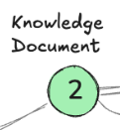
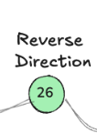
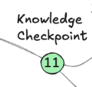
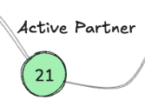
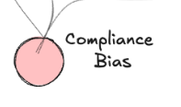
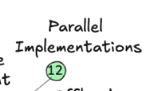
Patterns
Vomit
Interview

Slide 20
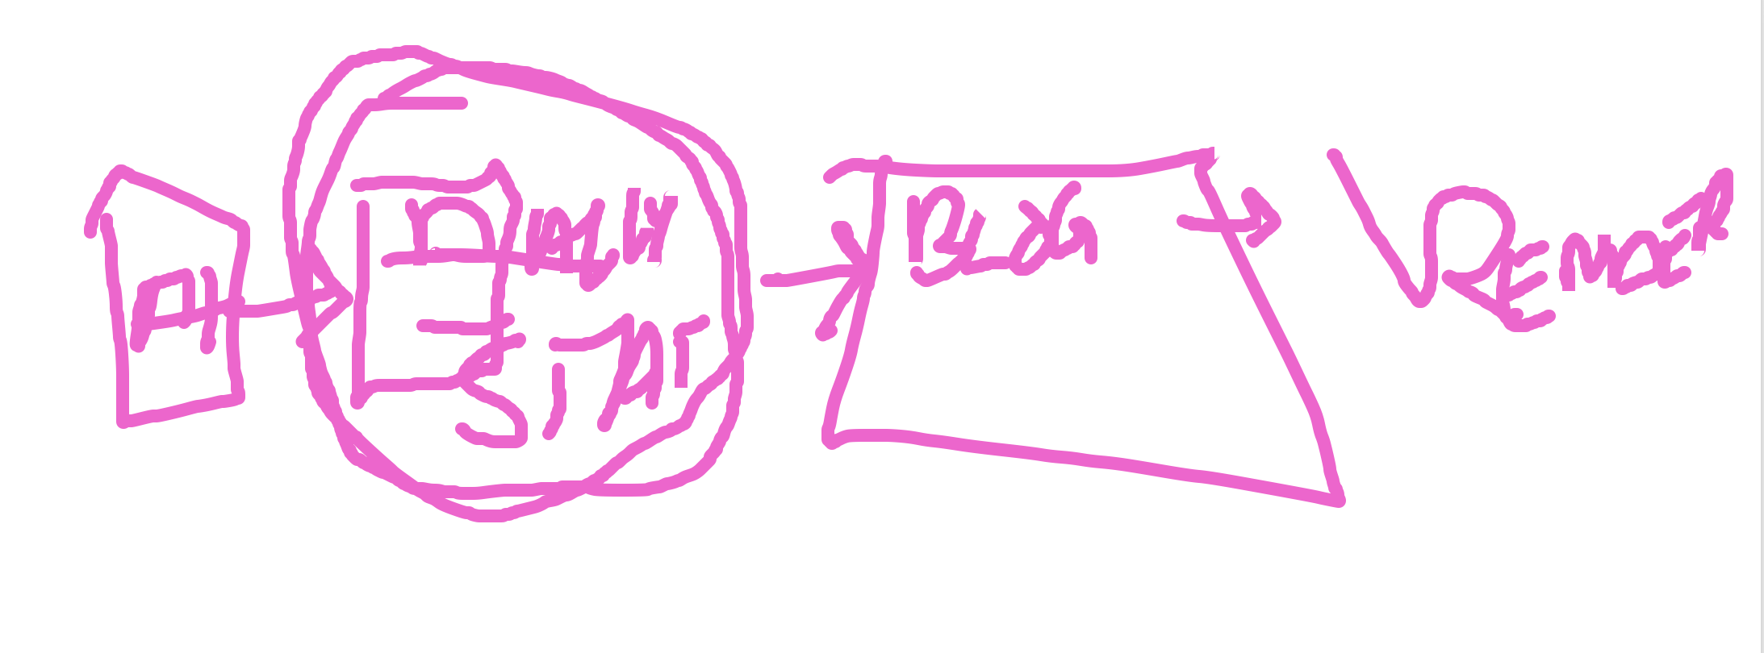

Slide 21
Data == Daily Journal

Slide 22
Retreat
Analysis

Slide 23
Building a second brain Collect Organize Distill Extract

Slide 24
Stuck
I have nothing
I have garbage

Slide 25
Vomit

Slide 26
Cleanup
Vomit
1st Draft
Refine & Clarify
“Done is better than perfect”
“Perfect is the enemy of the good”
“The simplest thing that can possibly work”
“YAGNI”

Slide 27
Interview
Vomit
Interview
Collectin 1st Draft
Refined Output

